Slide 1
A DGR Category for Community Foundations
Charity Law Association of Australia and New Zealand 2019 Conference
1 August 2019
Krystian Seibert – Industry Fellow, Centre for Social Impact, Swinburne University of Technology

Slide 2
What are Community Foundations?
They are community-owned, not-for-profit, charitable organisations which exist for public benefit [in a specific, named geographic area]
Their shared purpose is to attract resources to support and revitalise local communities and build social capital. They make philanthropic grants, and often seek to build a perpetual financial asset for their community
They are managed by voluntary boards, or have input from advisory committees from the local area. Some also employ a small number of staff, often only 1 or 2 paid employees supported by volunteers
They have multiple sources of funding from a range of donors and supporters

Slide 3
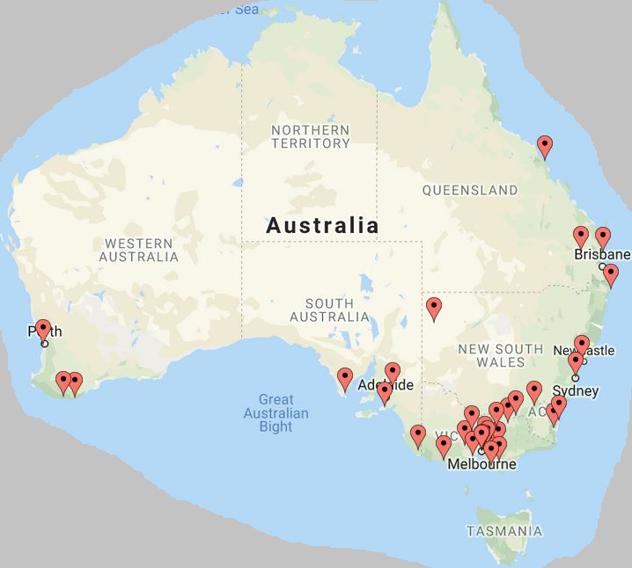





There are 38 community foundations in Australia

Slide 4
Structure Based on Current Regulatory Framework

Slide 5
Problems…

Slide 6
Proposed Solution
Create a new ‘Item 1’ deductible gift recipient category within Division 30 of the Income Tax Assessment Act 1997 (Cth) specifically for community foundations.

Slide 7



Advocating for Change
  Community foundations and their supporters have been advocating to address this issue since the early 2000s
  But they have not been able to make much progress
  Most recently, in 2017 there was a joint proposal from Philanthropy Australia and Australian Community Philanthropy to the Australian Government
  In response, the Minister for Revenue referred the issue to the Board of Taxation for advice

Slide 8
The Response
  The Board of Taxation was concerned with integrity risks that the proposal would raise:
    Difficult to ensure the only ‘genuine’ community foundations are eligible for the category → The definition of community foundation is a bit fuzzy, so you may get a range of organisations trying to use it to get DGR status
    The category would effectively enable tax deductible giving to non-DGRs → You could give to your ‘sub-fund’ with a community foundation, and then recommend that a grant be to made to a local sports club (which can’t get DGR status)
  However the Board of Taxation did recognise the problem with the restriction against PAFs making grants to community foundations
  Outcomes:
    The Government did not agree to introduce a new DGR category for community foundations
    But the Government did agree to explore how to address the restriction against PAFs making grants to community foundations

Slide 9
In short, the Government can’t be certain that funds benefiting from a tax deduction will be used for the purposes government intends them to be used for
This could be characterised as an agency problem

Slide 10
Reflections
  In the United States donations to all ‘public charities’ are tax deductible – unlike in Australia
  Community foundations are just another type of public charity
  So you don’t confront issues 1 and 2 that the Board of Taxation identified
  Nor is there the issue with receiving grants from private foundations – private foundations are designed to make grants to public charities!
  Similar situation in Canada and the United Kingdom
  Perhaps the problems confronting community foundations in Australia won’t be resolved until there is broader reform of the DGR framework, to move it towards that of the United States – one where most charities would be eligible for DGR status
  Meanwhile, community foundations are making do with the existing framework → Some whose focus is primarily on addressing disadvantage are establishing themselves (or a related structure) as a ‘Public Benevolent Institution’

